Slide 1

CS302 Design and Analysis of Algorithms
Muhammad sohail afzal

Slide 2
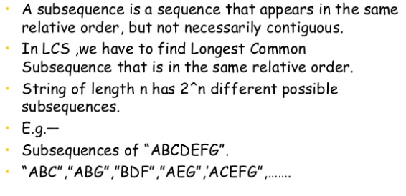
Longest Common Sub-sequence (LCS): Dynamic Programming

Slide 3
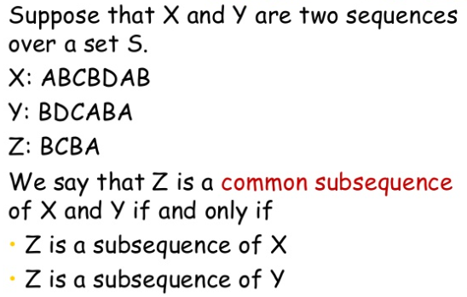
Longest Common Sub-sequence (LCS): Dynamic Programming

Slide 4
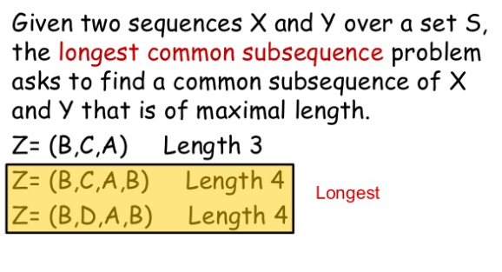
Longest Common Sub-sequence (LCS): Dynamic Programming

Slide 5
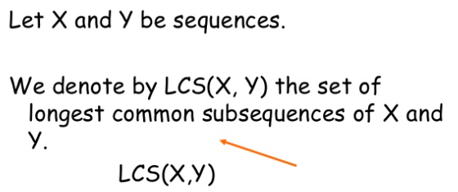
Longest Common Sub-sequence (LCS): Dynamic Programming

Slide 6
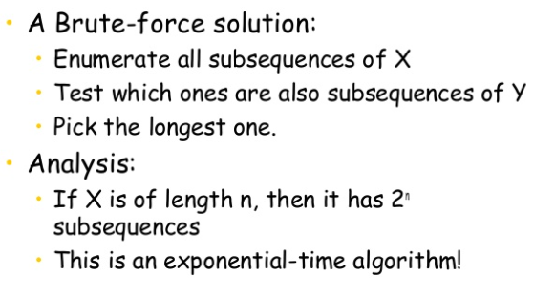
Longest Common Sub-sequence (LCS): Dynamic Programming

Slide 7
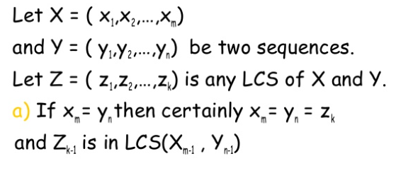
Longest Common Sub-sequence (LCS): Dynamic Programming

Slide 8
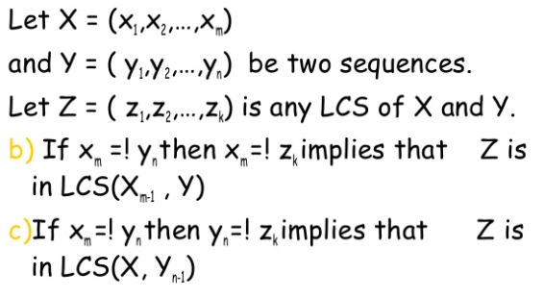
Longest Common Sub-sequence (LCS): Dynamic Programming

Slide 9
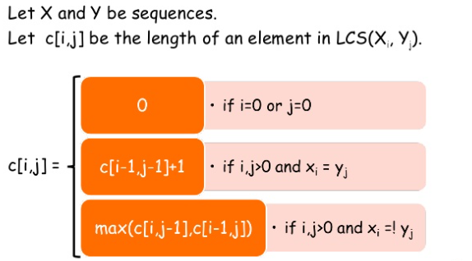
Longest Common Sub-sequence (LCS): Dynamic Programming

Slide 10

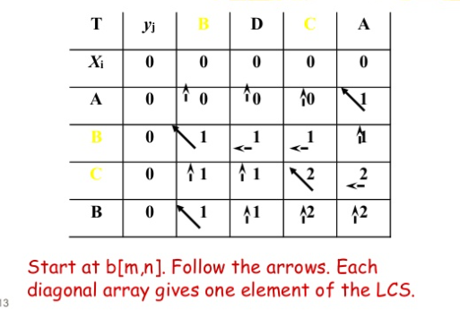
Longest Common Sub-sequence (LCS): Dynamic Programming

Slide 11
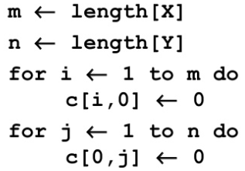


Longest Common Sub-sequence (LCS): Dynamic Programming

Slide 12
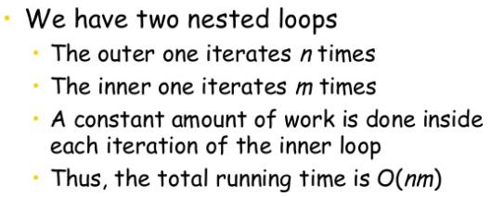
Longest Common Sub-sequence (LCS): Dynamic Programming

Slide 13
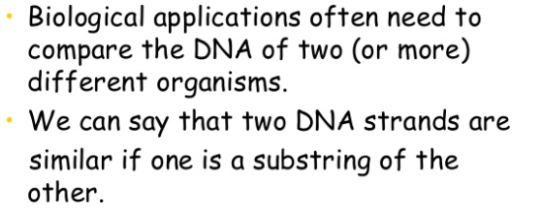
Longest Common Sub-sequence (LCS): Dynamic Programming

